Slide 1
Computer Architecture Experiment
Topic 3. Cache Design
浙江大学计算机学院
2021年9月

Slide 2
Outline
Experiment Purpose
Experiment Task
Basic Principle
Operating Procedures
Checkpoints

Slide 3
Experiment Purpose
Understand Cache Line.
Understand the principle of Cache Management Unit (CMU) and State Machine of CMU.
Master the design methods of CMU.
Master the design methods of Cache Line.
master verification methods of Cache Line.

Slide 4
Experiment Task
Design of Cache Line and CMU.
Verify the Cache Line and CMU.
Observe the Waveform of Simulation.

Slide 5
Cache Line

Slide 6
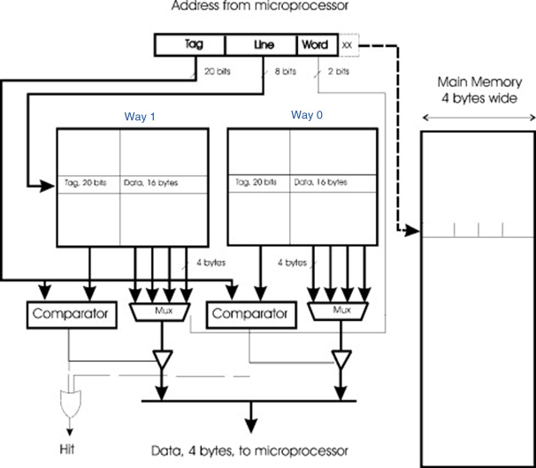

Cache Mode
2-way set associative
Write Back
Write Allocate

Slide 7
Address
Bytes of word = 4, WORD_BYTES_WIDTH = 2
Words of line = 4, LINE_WORDS_WIDTH = 2
Tag bits = 23
Address bits = 32
Ways = 2
LINE_INDEX_WIDTH = ADDR_BITS - TAG_BITS - LINE_WORDS_WIDTH - WORD_BYTES_WIDTH = ?
Line Number = ?
Notes:
6
2^6 = 32

Slide 8
Cache Line Memory
reg [LINE_NUM-1:0] inner_recent = 0;
reg [LINE_NUM-1:0] inner_valid = 0;
reg [LINE_NUM-1:0] inner_dirty = 0;
reg [TAG_BITS-1:0] inner_tag [0:LINE_NUM-1];
reg [WORD_BITS-1:0] inner_data [0:LINE_NUM*LINE_WORDS-1];

Slide 9
Input and output Signals of Cache Line
module cache (
input wire clk, // clock
input wire rst, // reset
input wire [ADDR_BITS-1:0] addr, // address
input wire load, // read refreshes recent bit
input wire store, // set valid to 1 and reset dirty to 0
input wire edit, // set dirty to 1
input wire invalid, // reset valid to 0
input wire [2:0] u_b_h_w, // select signed or not & data width
// please refer to definition of LB, LH, LW, LBU, LHU in RV32I Instruction Set
input wire [31:0] din, // data write in
output reg hit = 0, // hit or not
output reg [31:0] dout = 0, // data read out
output reg valid = 0, // valid bit
output reg dirty = 0, // dirty bit
output reg [TAG_BITS-1:0] tag = 0 // tag bits
);

Slide 10
Simulation Example(1)
// init
32'd10: begin
load <= 0;
store <= 1;
edit <= 0;
din <= 32'h11111111;
addr <= 32'h00000004;
end
32'd11: begin
addr <= 32'h0000000C;
end
32'd12: begin
addr <= 32'h00000010;
end
32'd13: begin
addr <= 32'h00000014;
end
// read miss
32'd14: begin
load <= 1;
store <= 0;
edit <= 0;
u_b_h_w <= 3'b010;
din <= 0;
addr <= 32'h00000020;
end
// read hit
32'd15: begin
u_b_h_w <= 3'b010;
addr <= 32'h00000010;
end

Slide 11
Simulation Example(2)
// write miss
32'd16: begin
load <= 0;
store <= 0;
edit <= 1;
u_b_h_w <= 3'b010;
din <= 32'h22222222;
addr <= 32'h000000024;
end
// write hit
32'd17: begin
u_b_h_w <= 3'b010;
addr <= 32'h00000014;
end
// read line 0 of set 0, set recent bit
32'd18: begin
load <= 1;
store <= 0;
edit <= 0;
u_b_h_w <= 3'b010;
din <= 0;
addr <= 32'h00000004;
end
// store to line 1 of set 0 due to line 0 recent
32'd19: begin
load <= 0;
store <= 1;
edit <= 0;
u_b_h_w <= 3'b010;
din <= 32'h33333333;
addr <= 32'h00000204;
end

Slide 12
Simulation Example(3)
// edit line 1 of set 0, set dirty & recent
32'd20: begin
load <= 0;
store <= 0;
edit <= 1;
u_b_h_w <= 3'b010;
din <= 32'h44444444;
addr <= 32'h00000204;
end
// read line 0 of set 0, set recent bit
32'd21: begin
load <= 1;
store <= 0;
edit <= 0;
u_b_h_w <= 3'b010;
din <= 0;
addr <= 32'h00000004;
end
// read miss, tag mismatch. output tag (of line 1), valid and dirty == 1
32'd22: begin
load <= 1;
store <= 0;
edit <= 0;
u_b_h_w <= 3'b010;
din <= 32'h0;
addr <= 32'h00000404;
end
// auto replace line 1 of set 0
32'd23: begin
load <= 0;
store <= 1;
edit <= 0;
u_b_h_w <= 3'b010;
din <= 32'h55555555;
addr <= 32'h00000404;
end

Slide 13
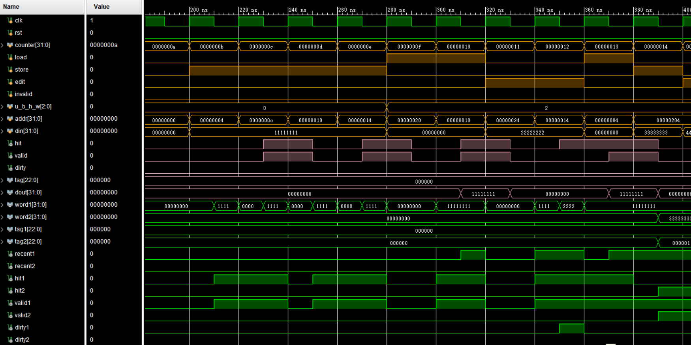
Simulation Example(1)

Slide 14
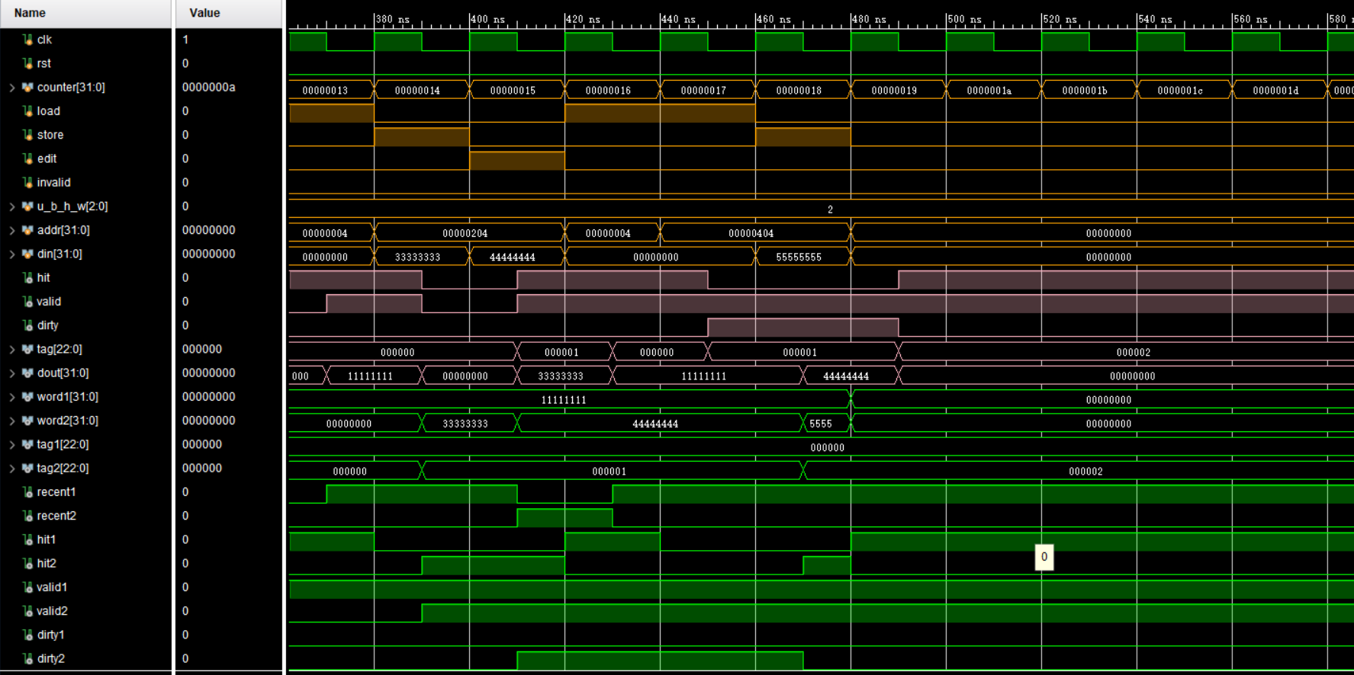
Simulation Example(2)

Slide 15
Simulation
Write Simulation Code yourself
cache initialization
read
miss
hit
write
miss
hit

Slide 16
Checkpoints
CP1:
Waveform Simulation of Cache Line.

Slide 17
Thanks!

